Slide 1

Computer Basics
Chapter One

Slide 2
Computer as an essential tool for the verity of application

Slide 3
System : Is a set of co-operative elements works together to perform a task (tasks) according to relational rules.
System
Input
Output
System process the input tasks using the following Concept:
(Buffering the input → processing → providing the needed output)

Slide 4
Environment
System
Boundary
Elements
Data
Input
Output
Information
Processing
System Structure

Slide 5
Data & Information
Data : Is a set of Disordered lexical elements
Example:( Ali, Book, College, dentistry, Rent )
Information : Is a set of Processed Data, that have some novelty other than a transmission media.
Example:
(Ali went to the college of Dentistry to rent a book)

Slide 6

+
=
Novelty
Communication Tool (Media)
Information
Information Properties

Slide 7

Solving
Processing
3
4
2
Output
Solution
Input
Questions
1
Effect
5
Data
Lexical Items
Environment
Store
Information
Novel answers
6
A Human being as a System

Slide 8

Affect
Affected

Slide 9

How one can solve a problem ?
Try
&
Error
Teaching
2
1
Industry
3

Slide 10

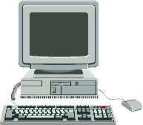
What do we mean by Computer ?
Any device that can convert Data to Information to produce a desired result.
2
Processing
1
Data
Information
Storing
4
3
Computer Functions

Slide 11
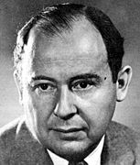
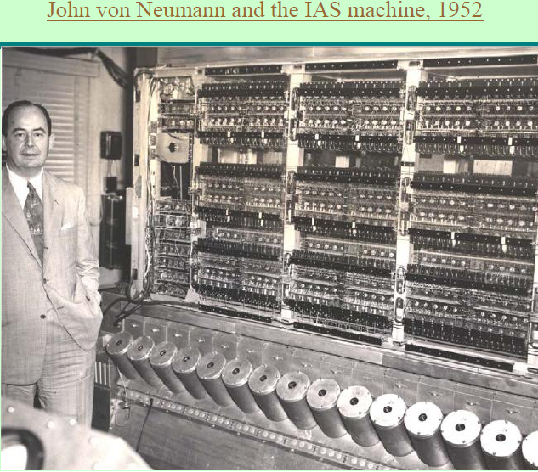
John Von Newman Rules for computer design
1) Individual Units.
2) Addressed Cells Memory.
3) Sequential Instruction
John Von Newman
1903 – 1957
Budapest – Hungary

Slide 12
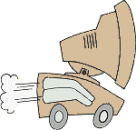
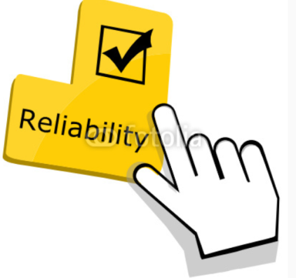

What makes a computer be a powerful device?
Computers are a desirable device because it have the following features :
Speedy → A computer can do billions of actions per second.
Trusty → A computer bring a trusted results
Storage → A computer can keep huge amounts of data.

Slide 13
1st Generation : 1945 - 1969
Vacuum Tubes
Very Large
Expensive
Special Purpose
Need Specialists
Hardware Problem
2nd Generation : 1970 - 1979
Transistors
Smaller (Still Large)
Expensive
Special Purpose
Need Specialist
Hardware Problem
3rd Generation : 1980 - 1990
Integrate Circuits (IC)
Smaller → Portable
Less Expensive
General Purpose
General Users
Software Problem
4th Generation : 1990 –
Small Integrate Circuits (IC)
Smallest → Portable
Cheap
General Purpose
General Users
Software Problem

Slide 14
Categories of Computers
(1) PC → (Desktop, Laptop,…)
(2) Mobile Computers → (Laptop, I Pad, …)
(3) Game consoles → Play station
(4) Server Computers → (Internet Server Provider)

Slide 15
Categories of Computers
(5) Mainframe Computers → Large Computers
(6) Super Computers → Large Computers
(7) Embedded Computers → Small design for specific task

Slide 16
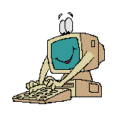

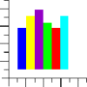

Interfacing
Via Applications
Applications

Slide 17
Type of interfacing
Text
Graphics
Multimedia

Slide 18
What do we mean by a good Software ?
A good Software should hold the following properties:
Traceable.
Portable.
Trusty.
Easy to use.
Cheap.

Slide 19


Computer Applications in
Dentistry

Slide 20
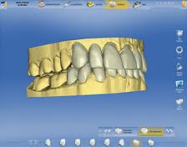
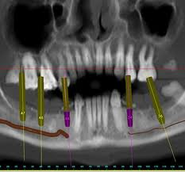
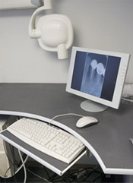

Slide 21
Computer Applications in Dentistry:
1) CAD and CAM
2) Digital X - Ray
3) Internet
4) Intra – Oral Camera
5) Optical Scanner
6) The Wand

Slide 22
Thanks

